Slide 1
EMODnet Data Ingestion: ‘Wake up your data’
General presentation – December 2020
Dick M.A. Schaap
MARIS

Slide 2
Situation
Quality controlled and accurate data of the marine environment are essential for many applications in the Blue Society for research, governance, and industry.
The costs of marine data collection by European organisations is circa 1.4 billion Euro per year: ~ 1.0 billion for in-situ; ~ 0.4 billion for remote sensing.
Nowadays, a major part is discoverable and accessible thanks to marine data management infrastructures, such as national data centres, SeaDataNet, EurOBIS, ICES, CMEMS, and others, whereby EMODnet has given an enormous boost to cooperation and seeking interoperabilty and harmonization.
However there is still a lot of valuable marine data collected and sitting at public authorities, research communities, and industry, which do not arrive at these repositories.

Slide 3
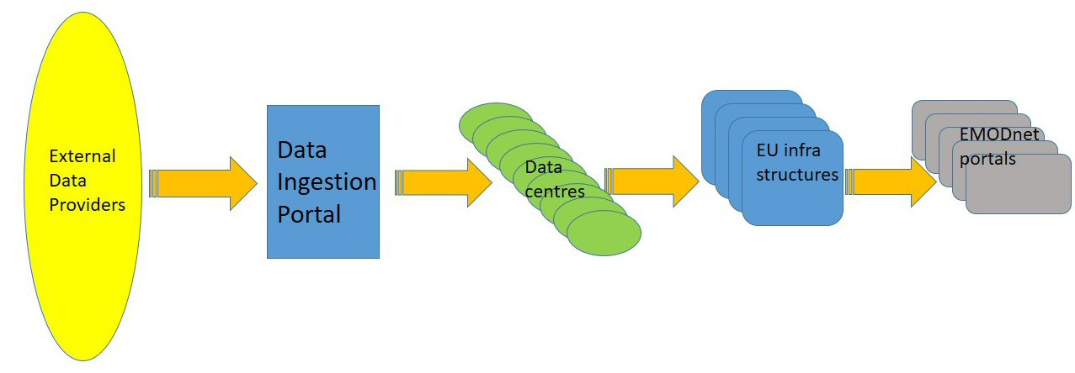
Aims of EMODnet Ingestion
To wake up idle datasets by identifying, encouraging and supporting their data holders
To launch and operate an extra EMODnet portal with services to facilitate data holders submitting marine data sets for publishing, further processing and safekeeping by expert data centres, and subsequent distribution through EMODnet thematic portals

Slide 4
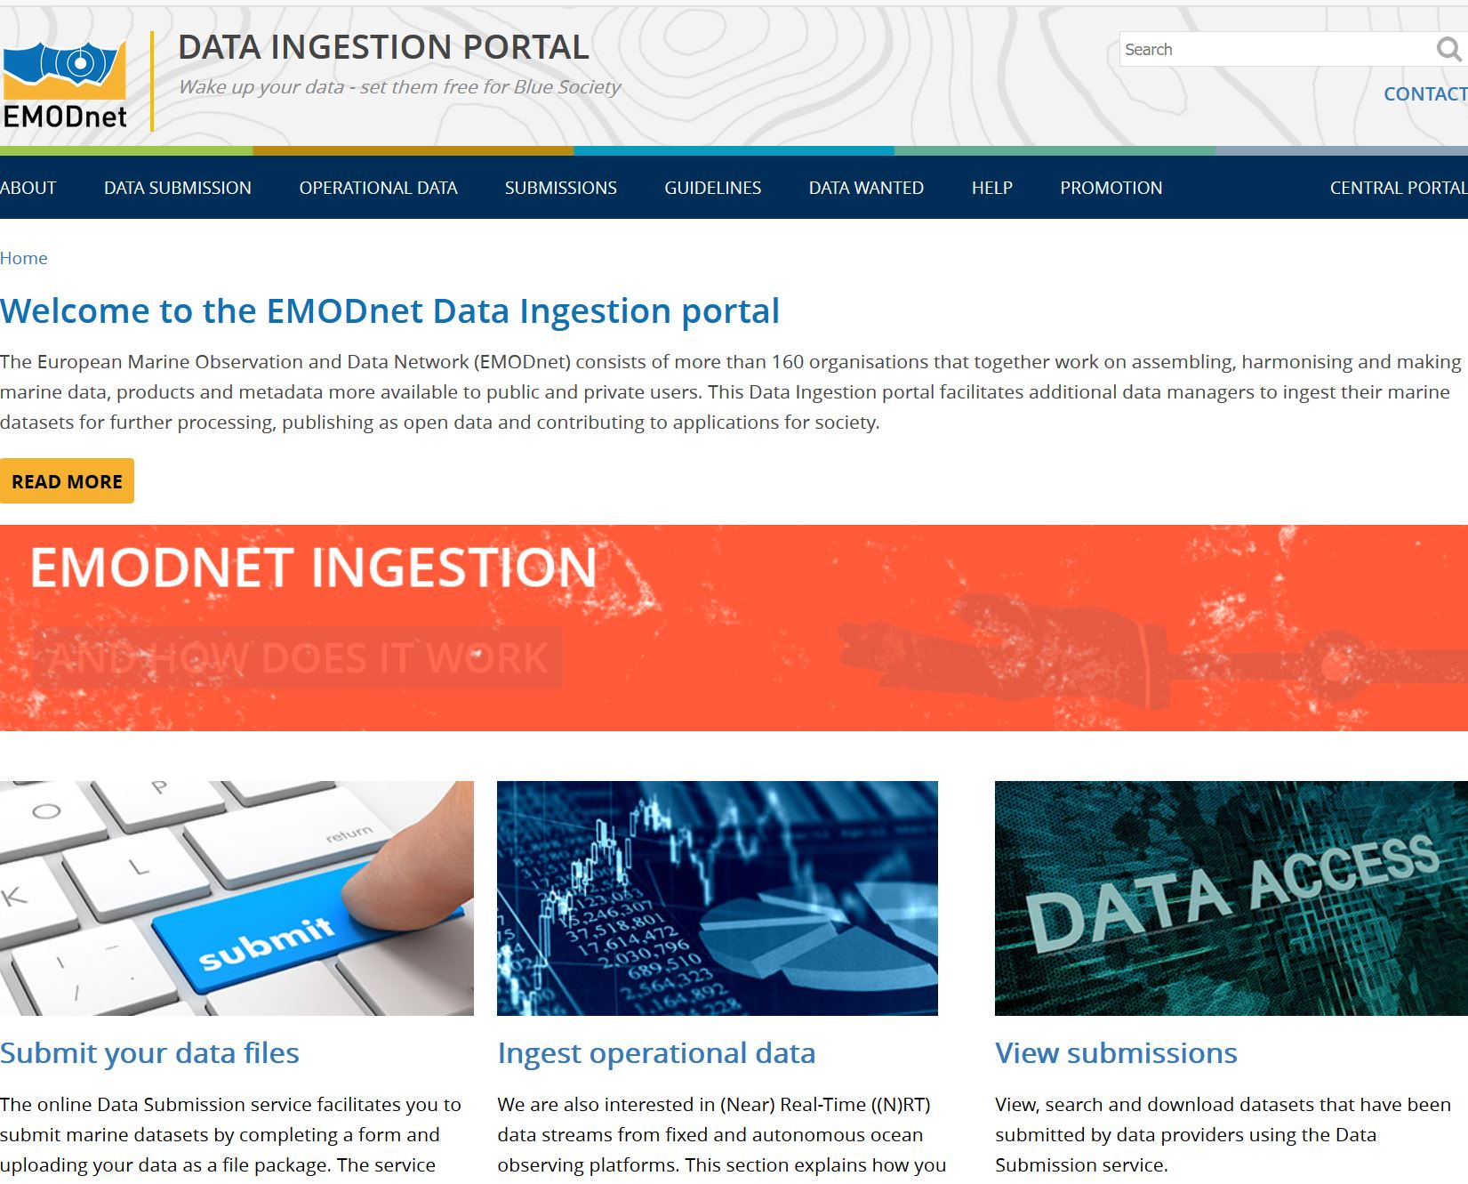
Portal – launched Feb 2017
www.emodnet-ingestion.eu

Slide 5
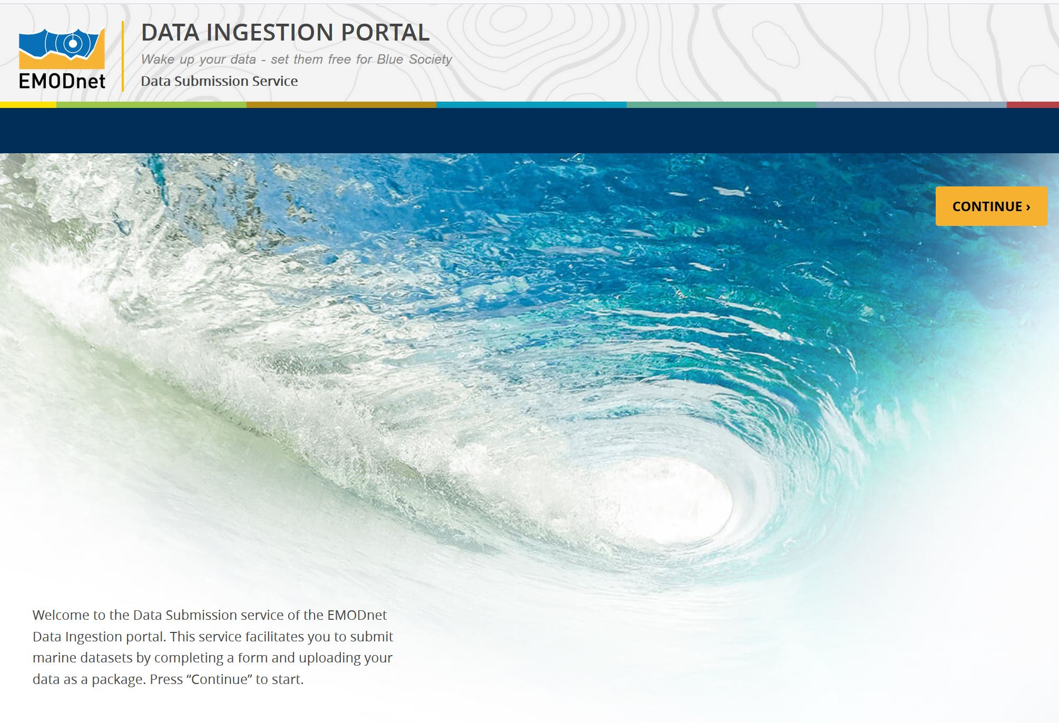
Submission Service for data files

Slide 6
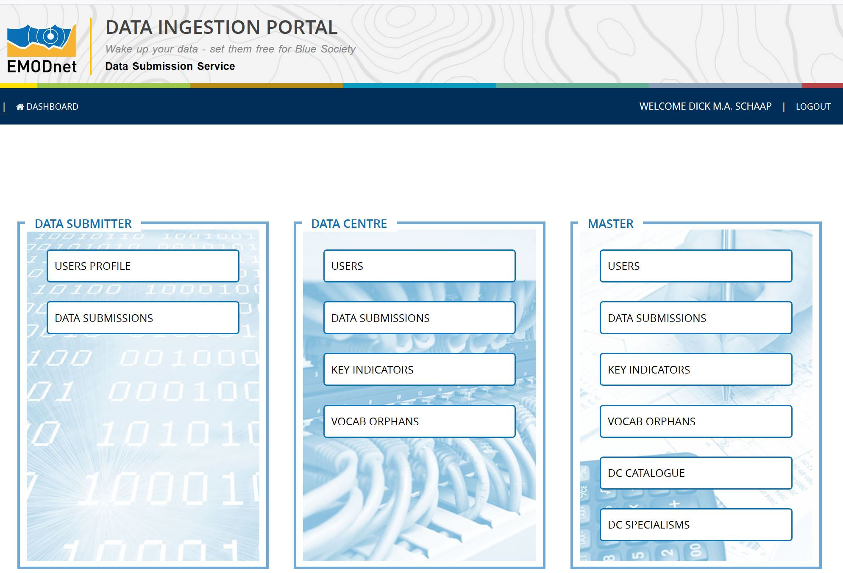
Data Submission Service
Dashboard with functions depending on role: Data Submitter; Data Centre; Master

Slide 7
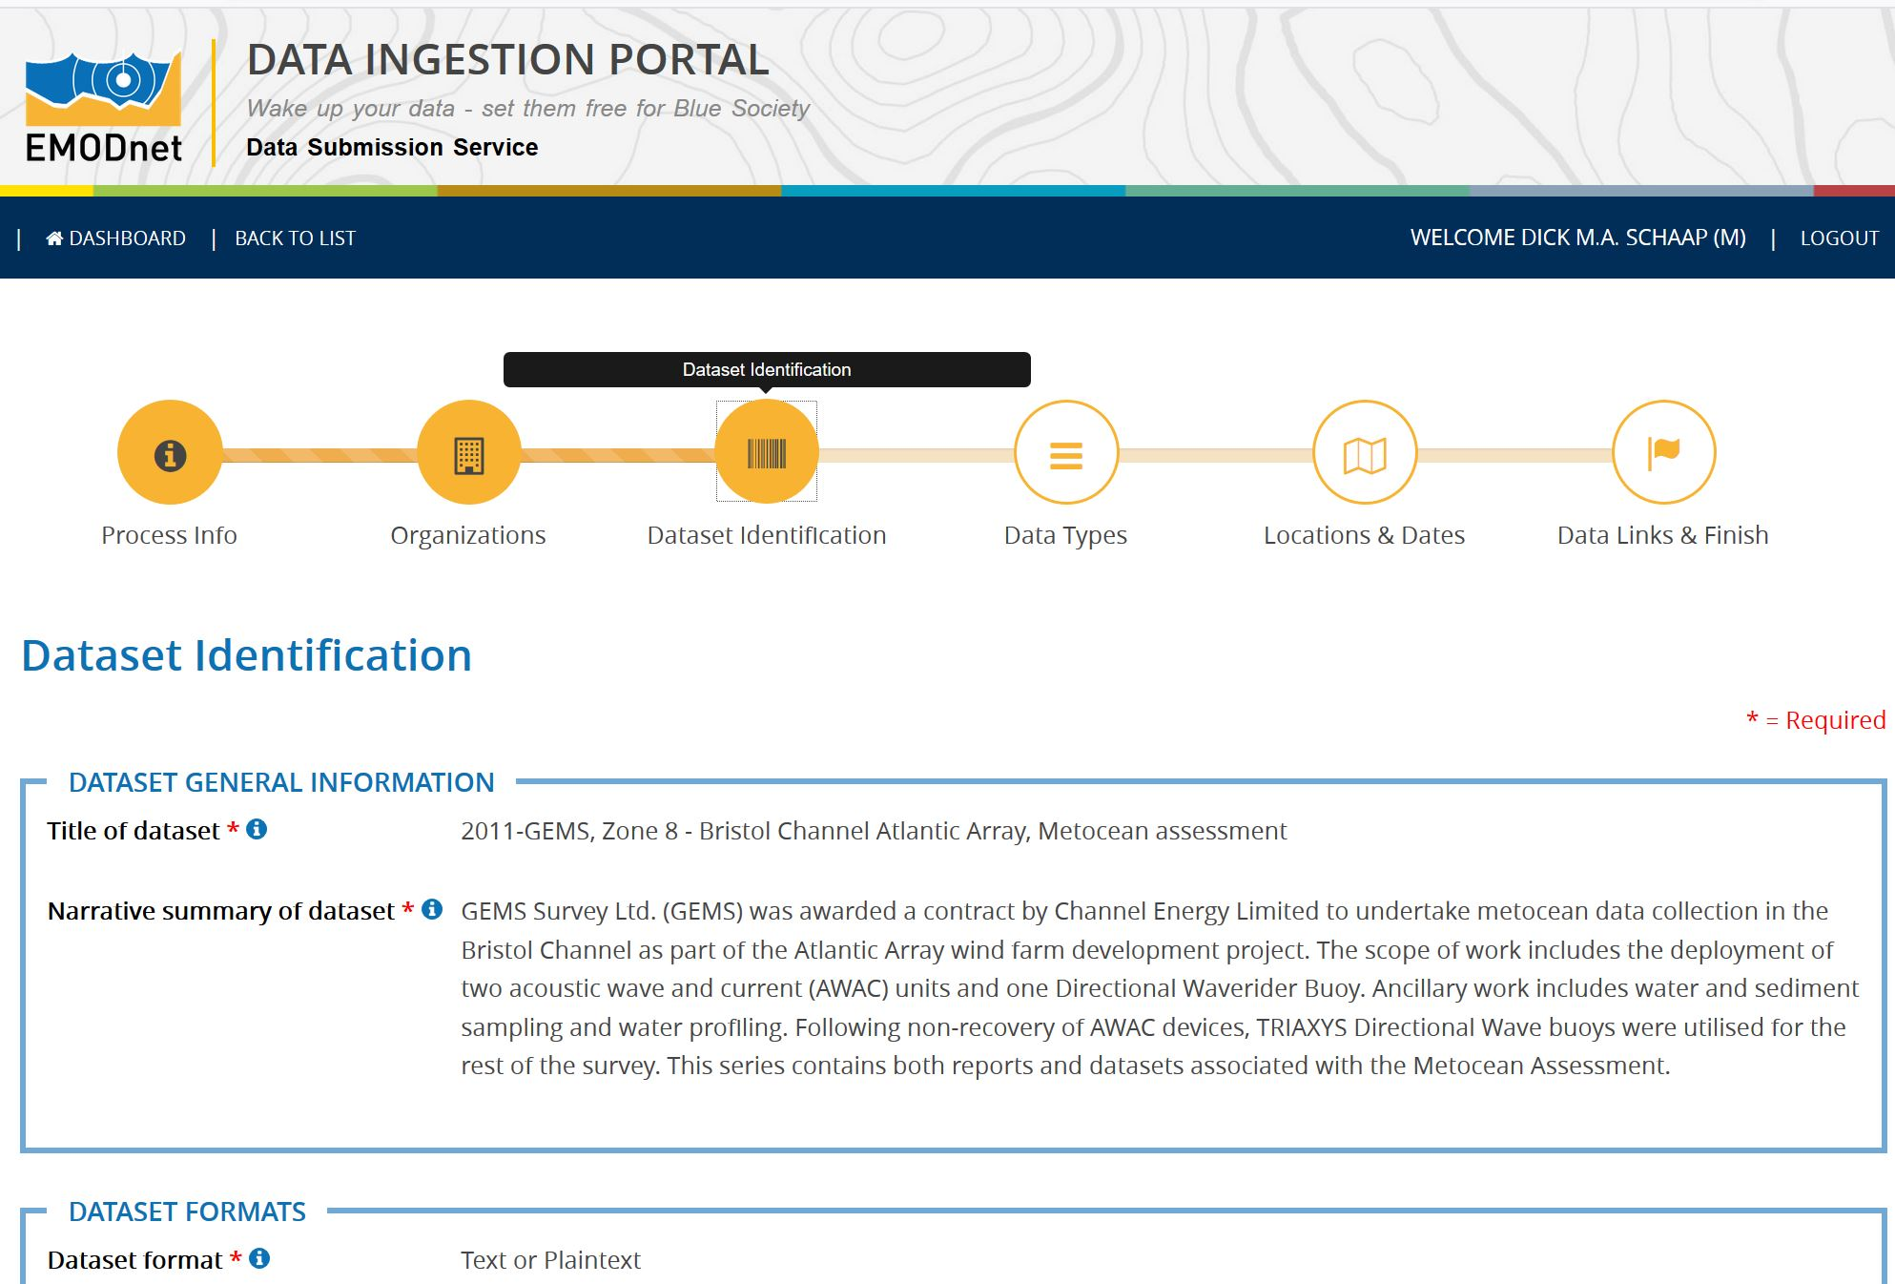
Data Submission service

Slide 8
Data Submission service
Distinction between 2 phases in the life cycle of a data submission:
  Phase I: from data submission to publishing ‘as is’
  Phase II: further elaboration and integration (of subsets) in national, European and EMODnet thematic portals.
Step 1: Data submitter completes a number of key fields of the submission form and uploads a zip file with the datasets and related documentation;
Step 2: Data Centre is assigned who reviews and completes the submission form for publishing ‘as is’ in Summary Service
Step 3: Data Centre elaborates, where possible, the data sets, resulting in availability in standard formats in EMODnet thematic portals

Slide 9
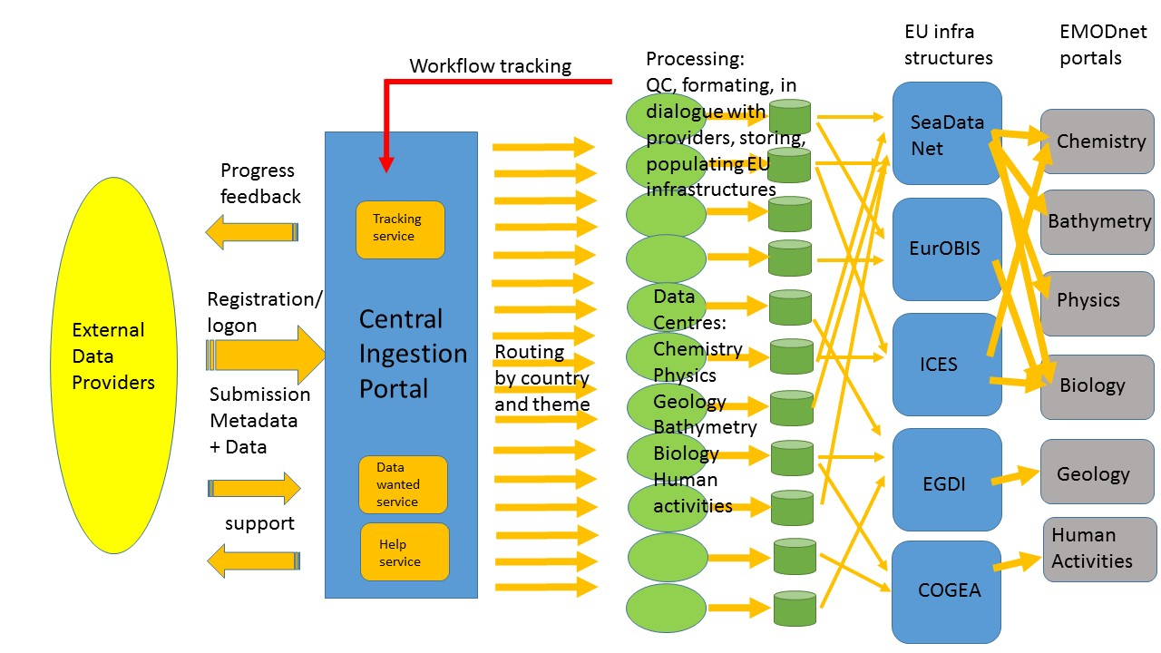
Data processing pathways

Slide 10
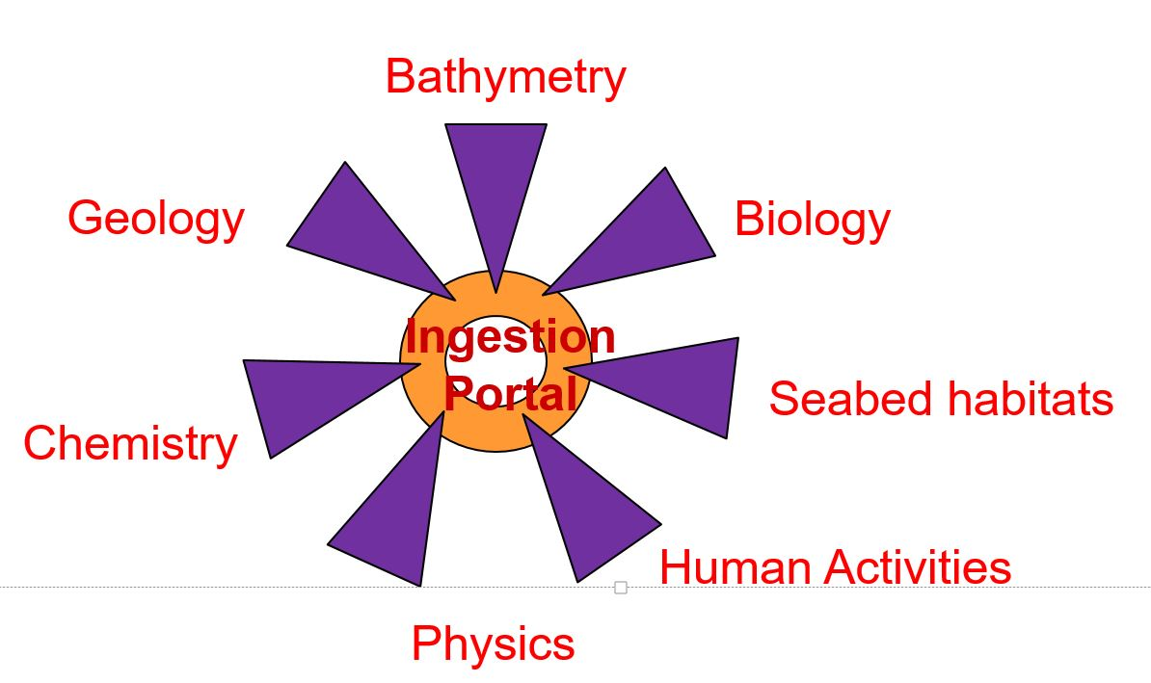
Pathways and collaboration with thematic lots
Network of data centres ‘recruited’ from EMODnet Ingestion and Thematic portals consortia to act as ‘assigned data centres’
At present 50 Data Centres covering all thematics

Slide 11

Network of expert data centres

Slide 12
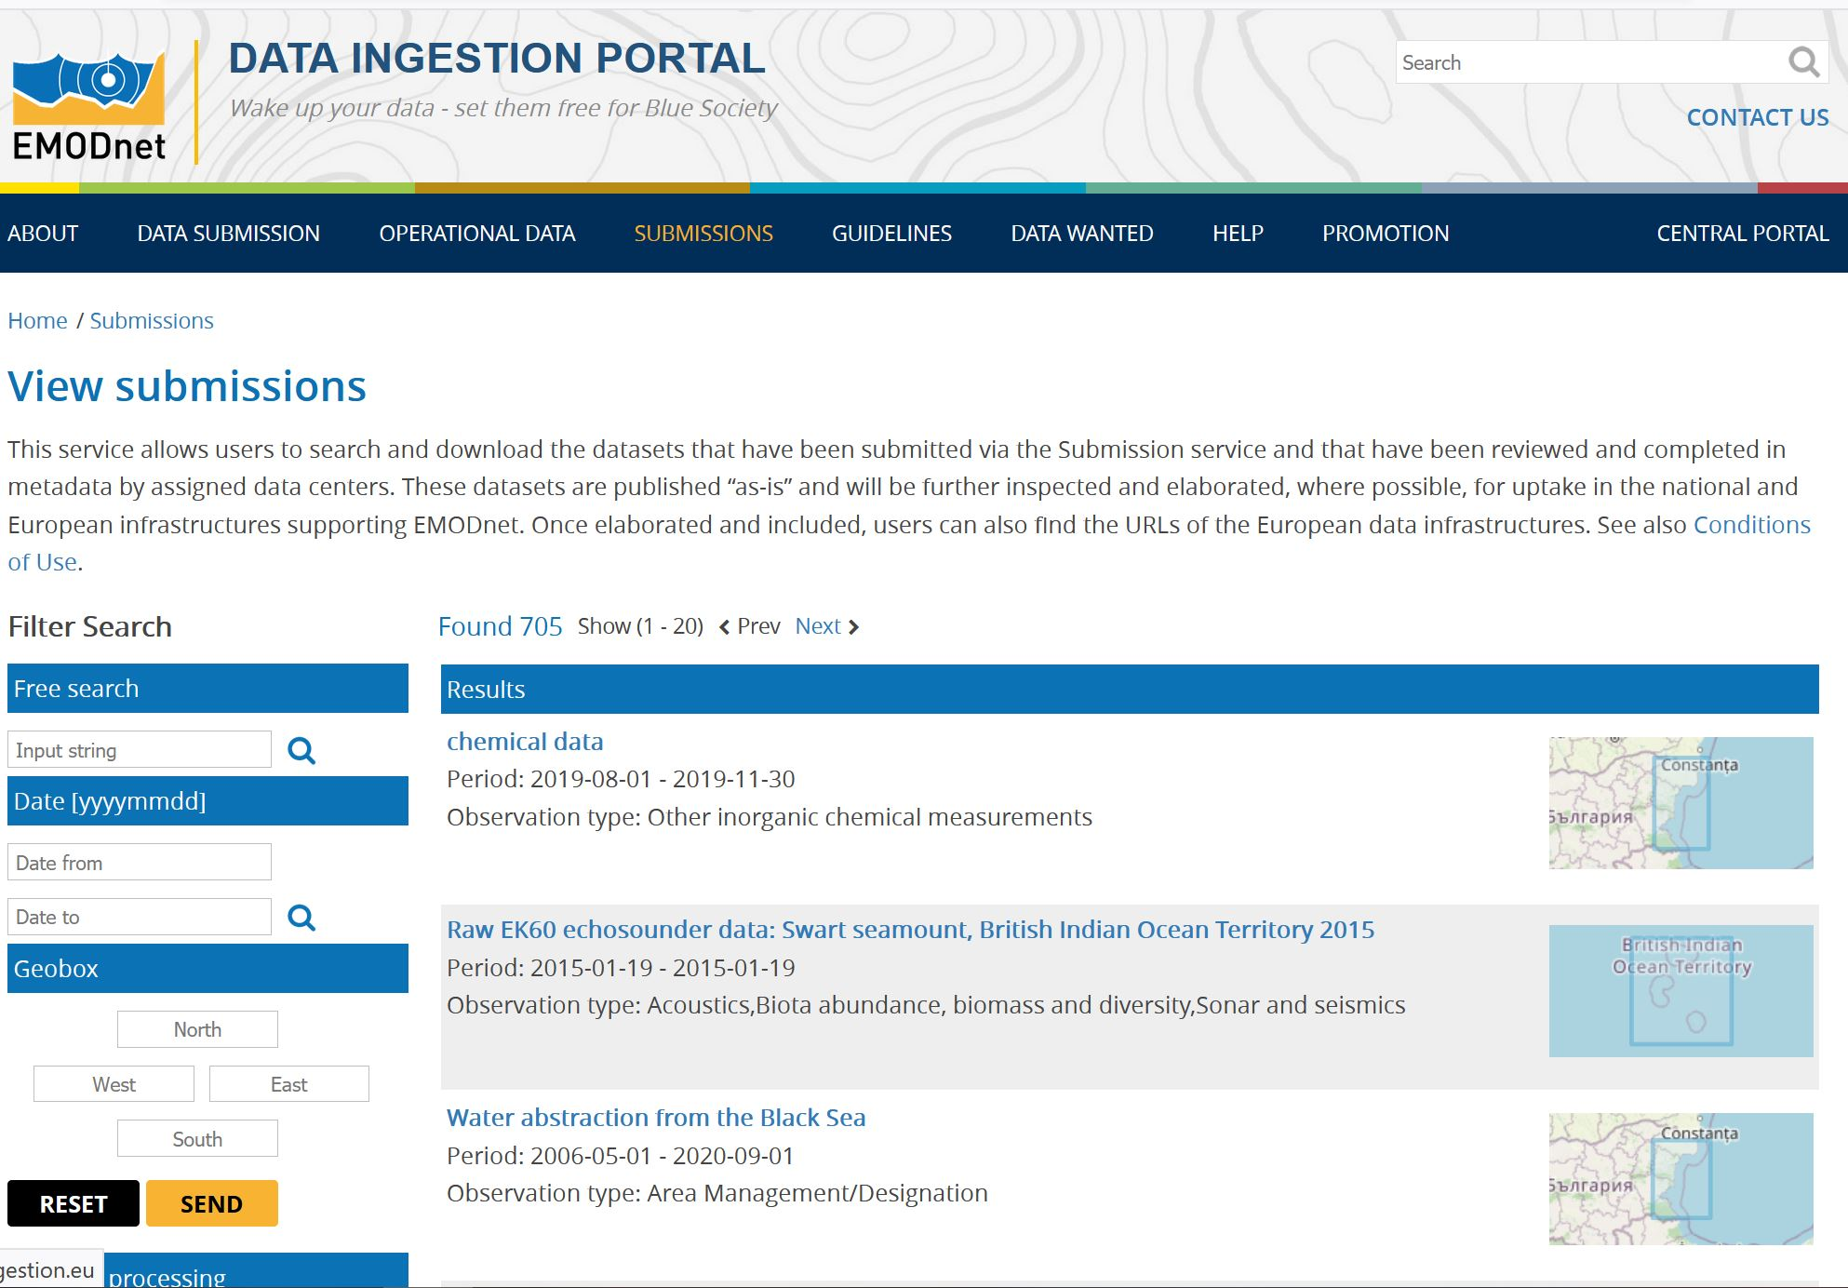
Submission Viewing service

Slide 13
Submission progress

Slide 14
Submission progress
(> 700 phase 1 – 2 records)

Slide 15
Data originators / submitters

Slide 16
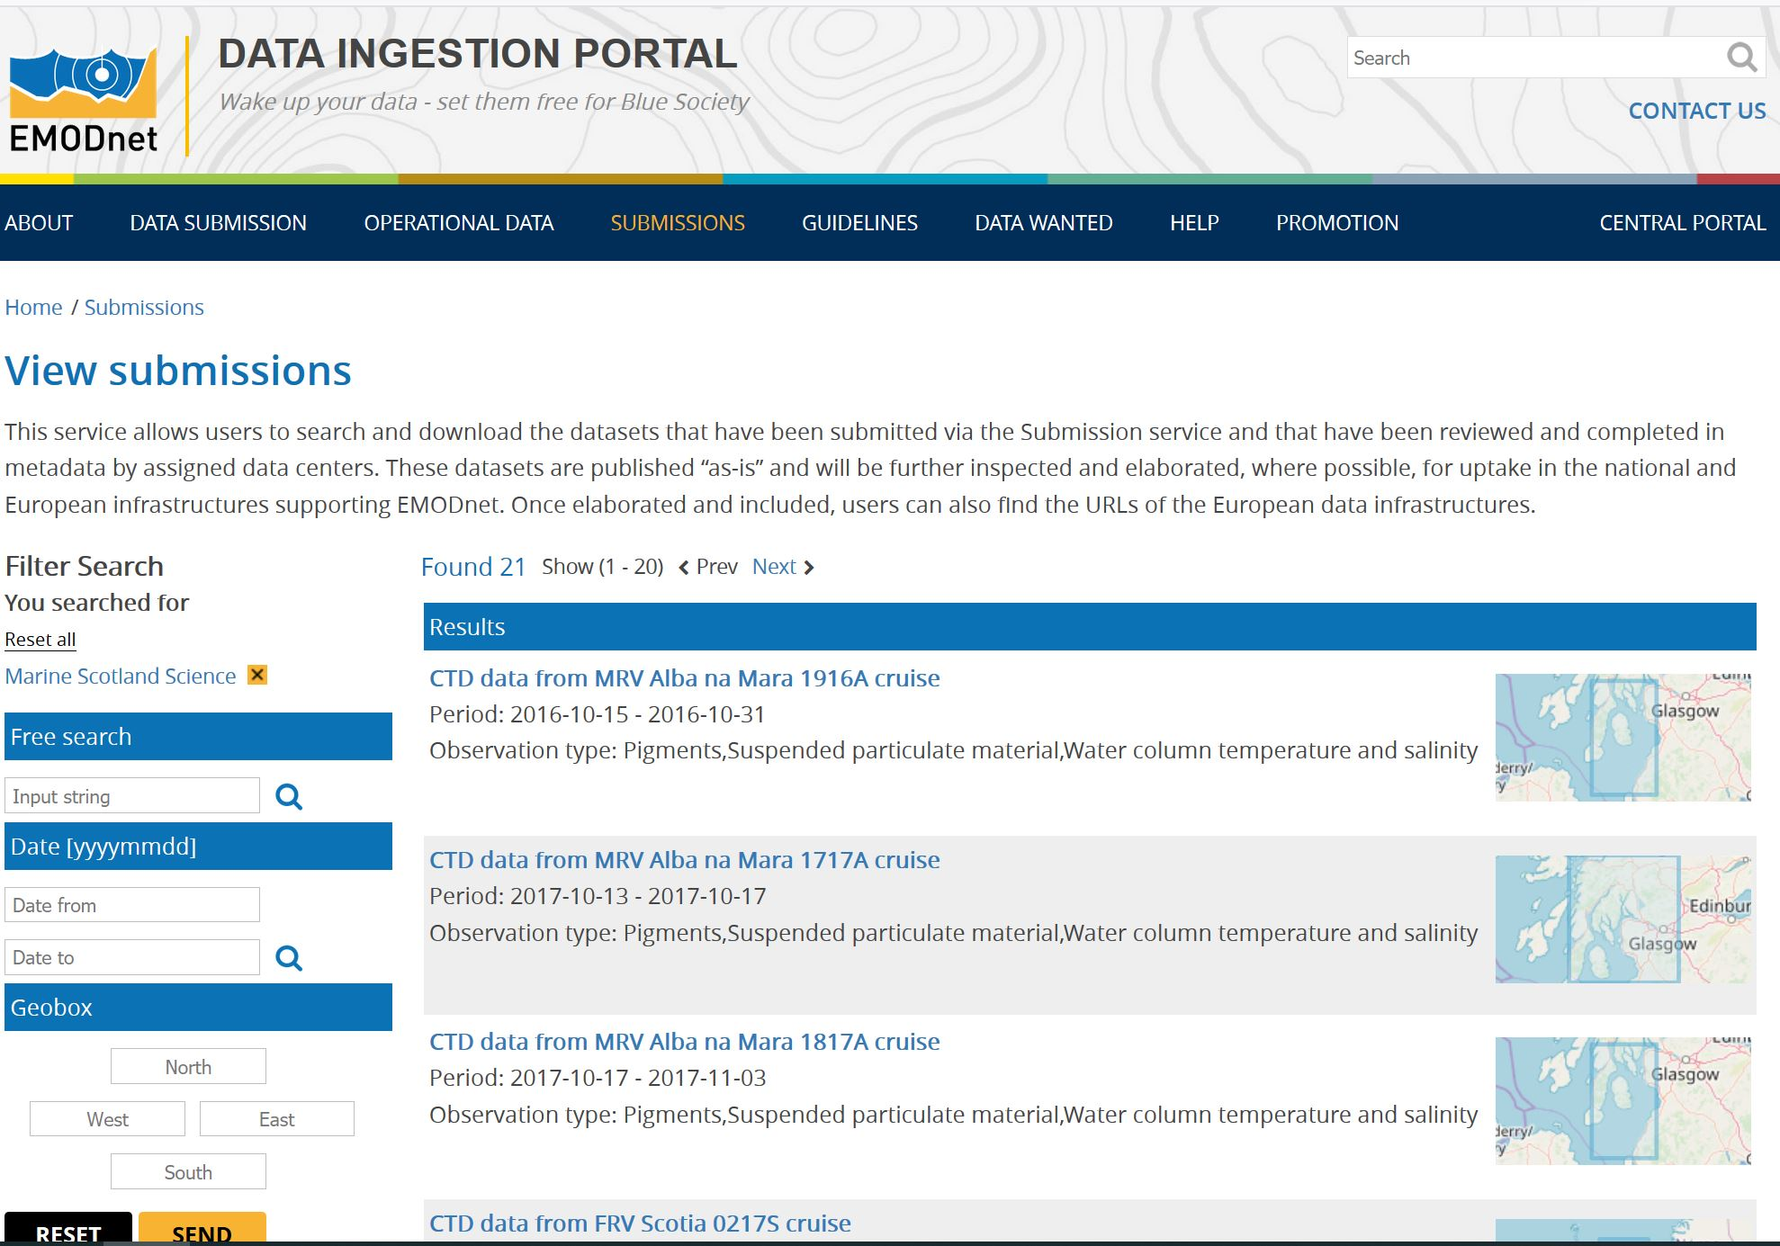
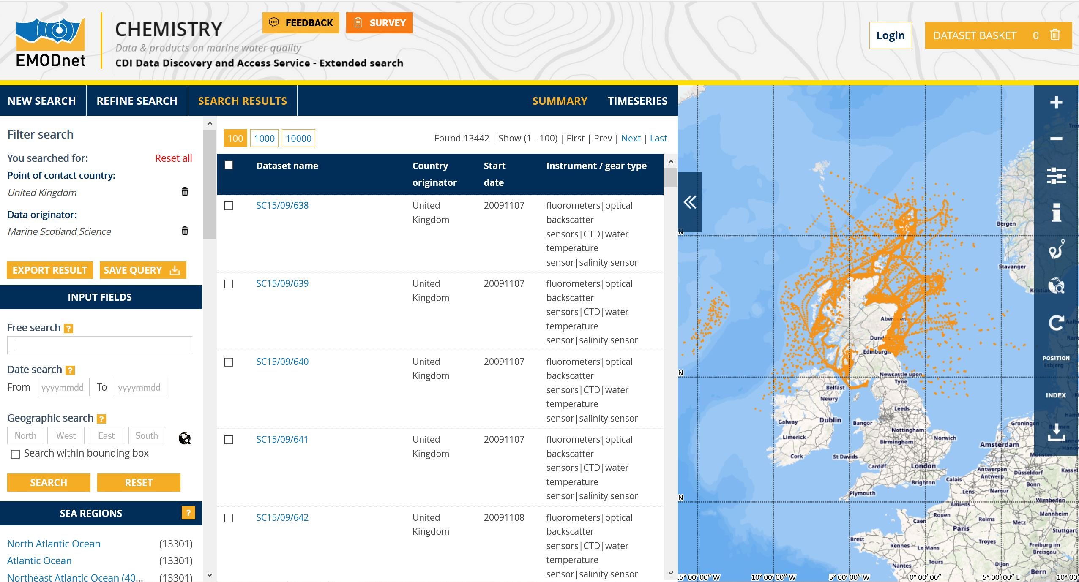
Data Summary Service
Example:
Marine Scotland
Science cruises:
Data now in
EMODnet
Chemistry

Slide 17
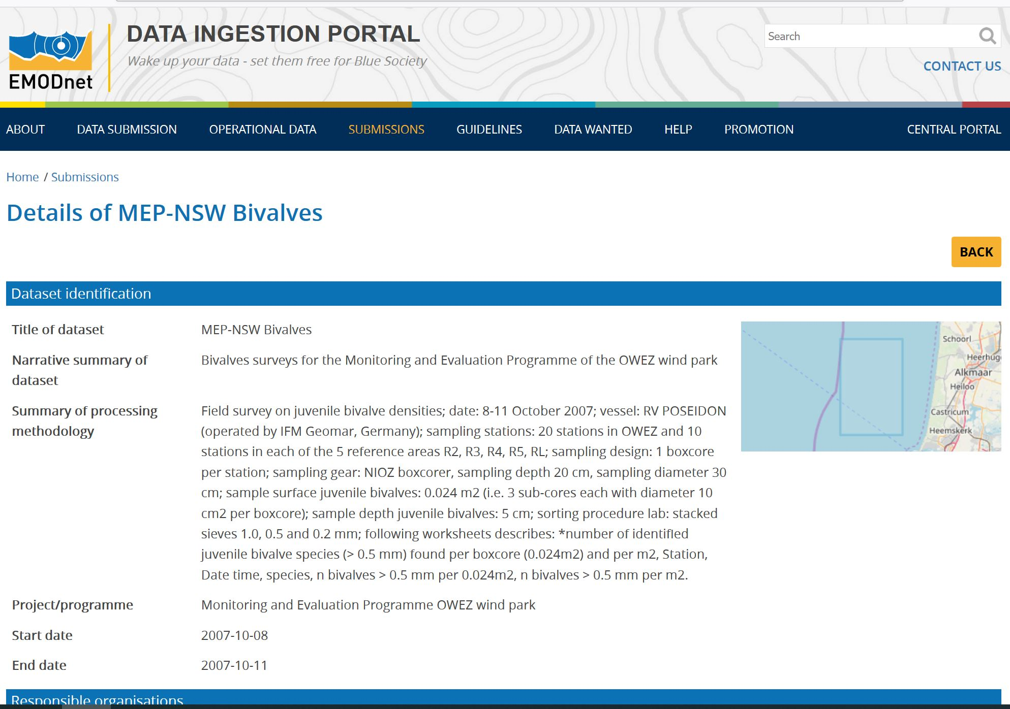
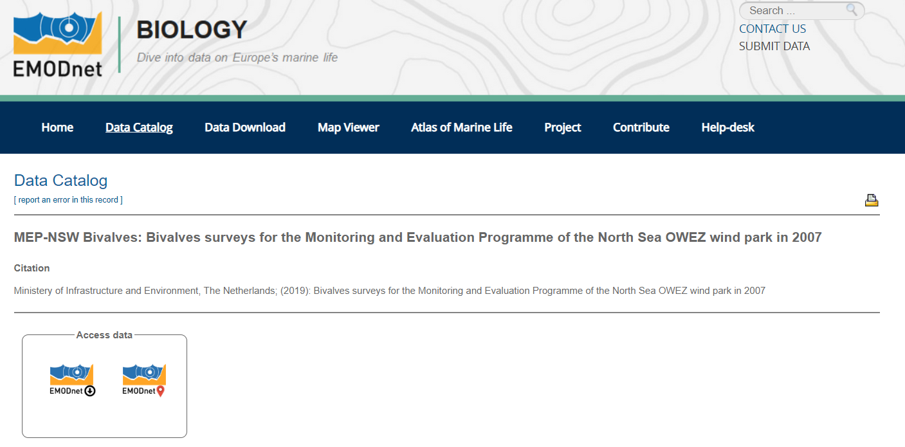
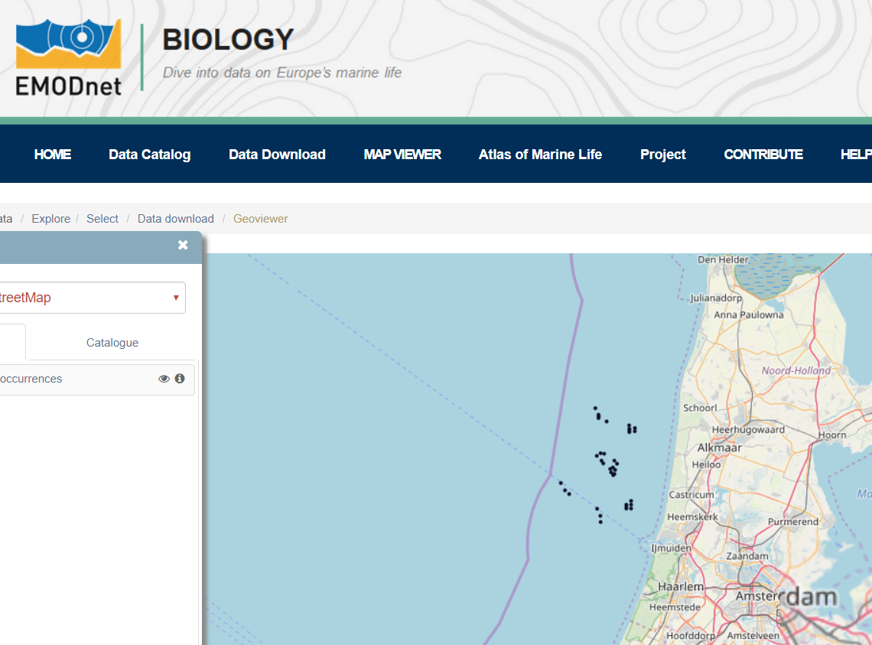
Data Summary Service
Example:
Biological
Monitoring of
Wind energy
Farms:
Data now in
EMODnet
Biology

Slide 18
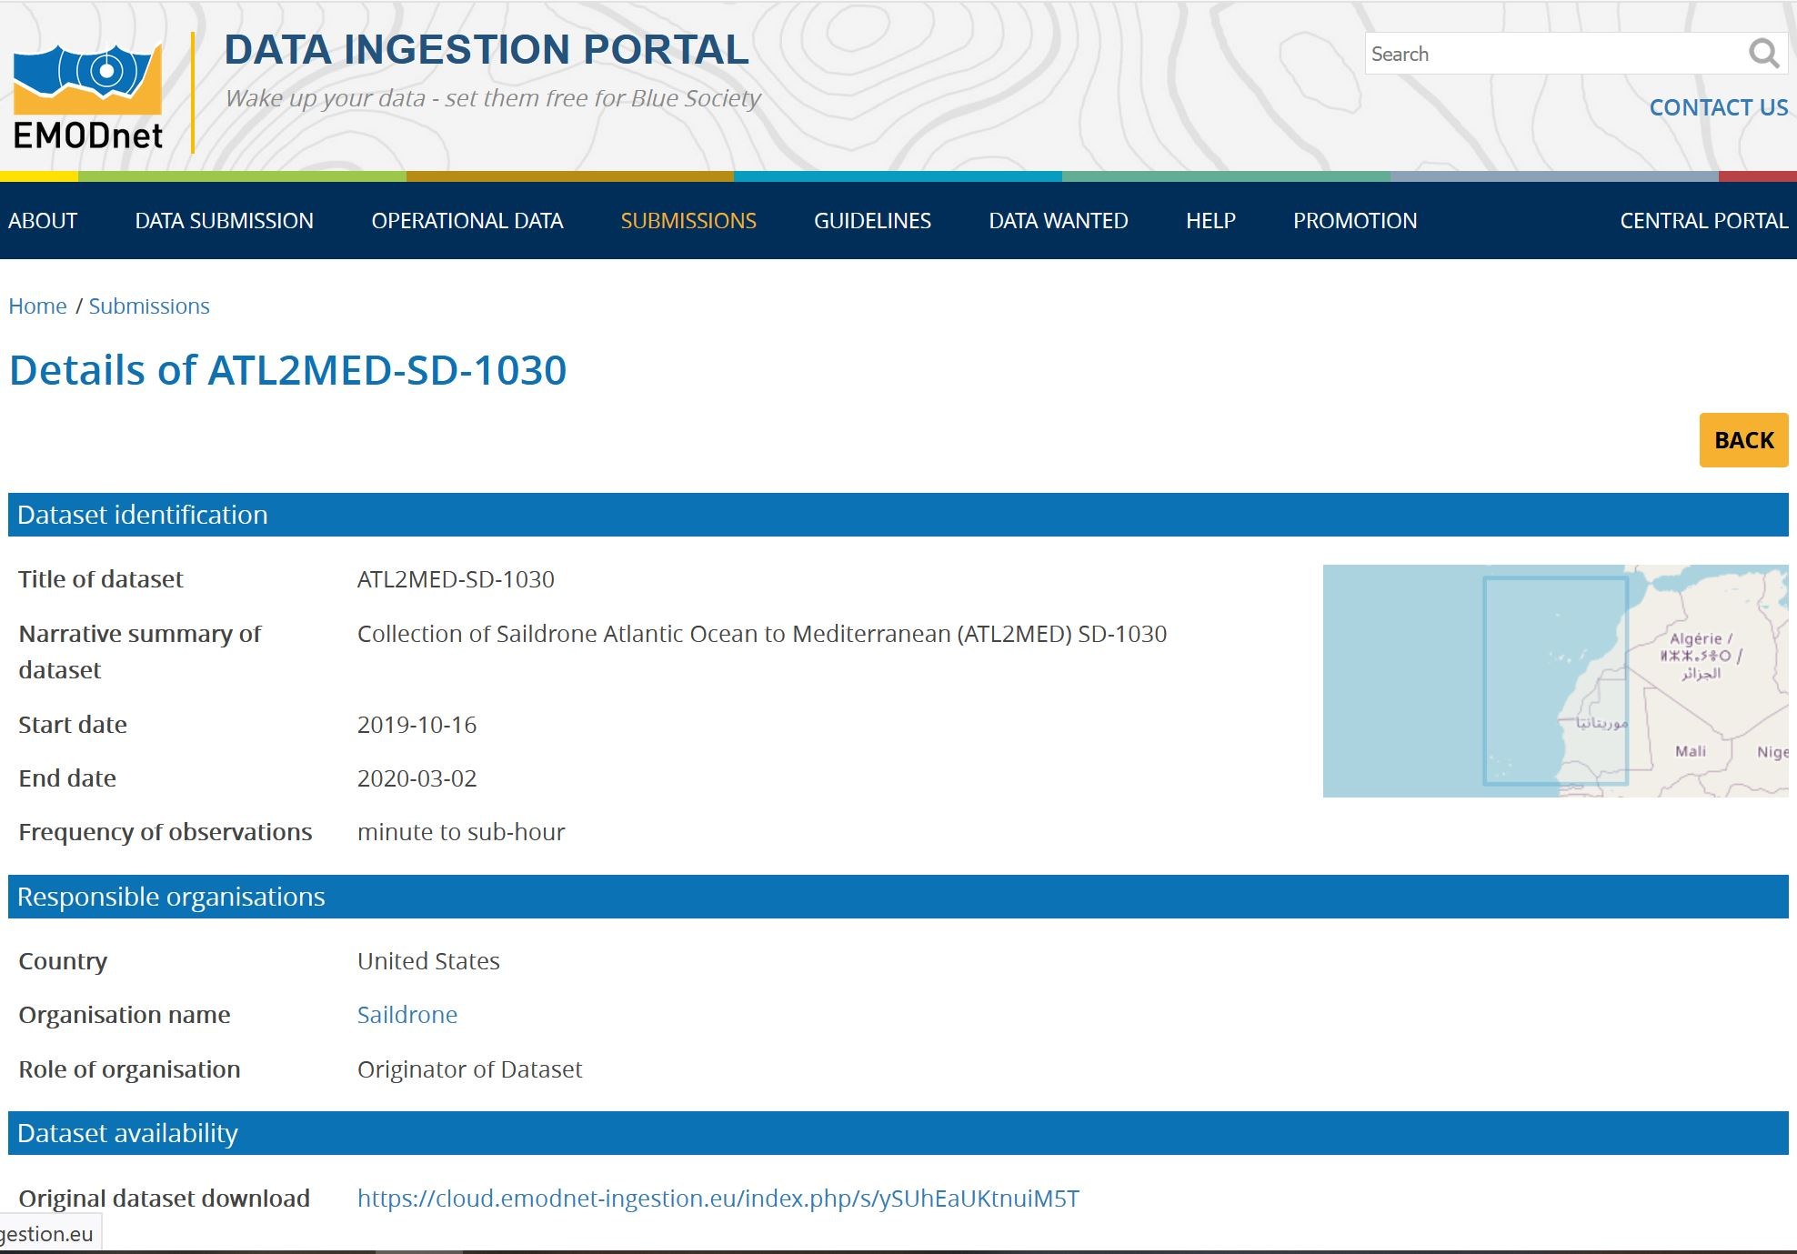
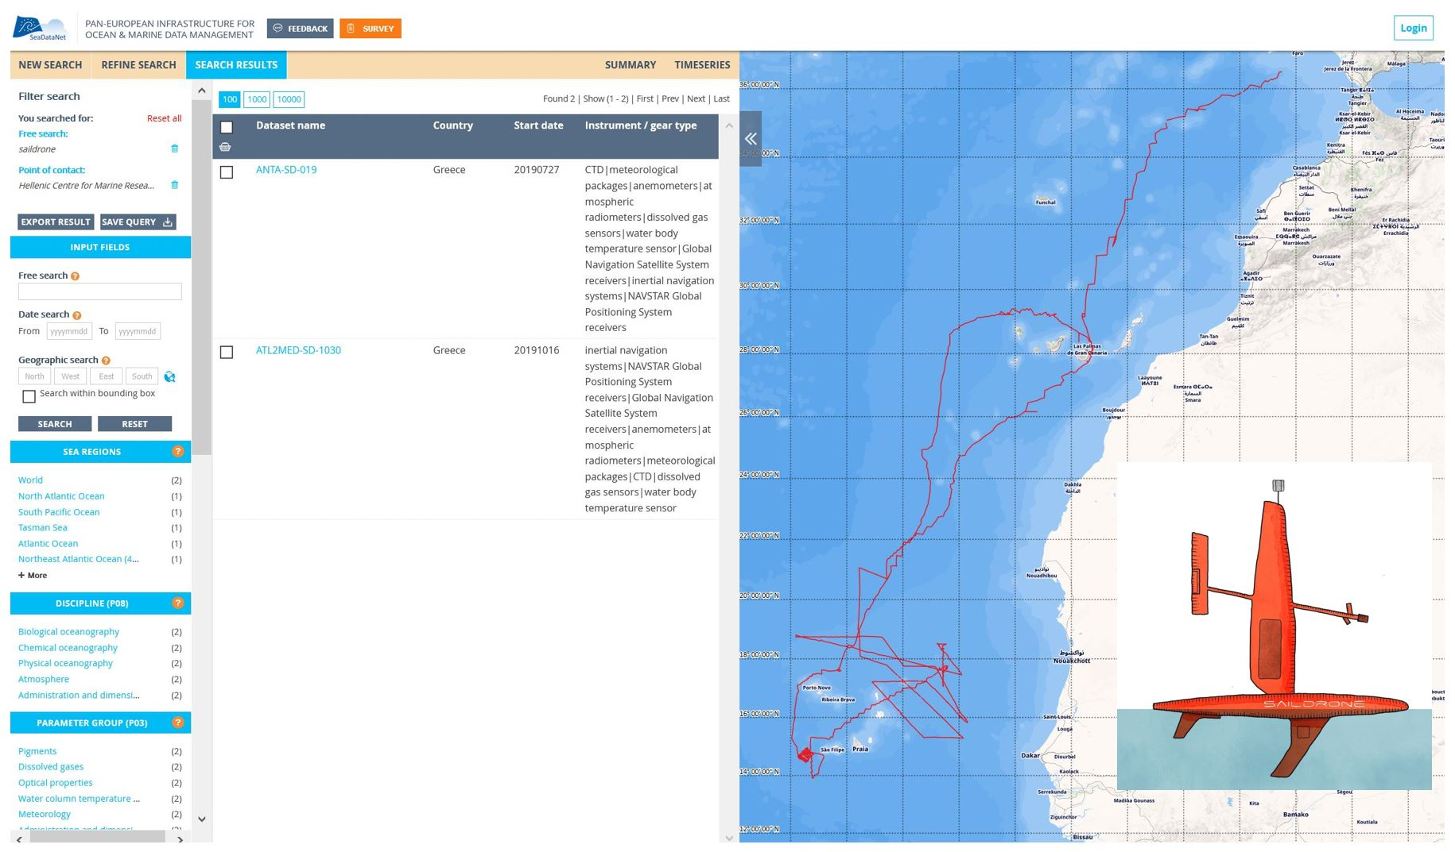
Data Summary Service
Example:
Saildrone
observations during
track in front of
West Africa:
Data now in
EMODnet
Physics

Slide 19
Marketing and outreach activities
Identify potential data sources and data providers
Reach out to potential data providers
Motivate data providers to participate with their data submissions
Market and promote the Data Ingestion service and its function in the overall EMODnet scheme
Data Centres function as EMODnet ambassadors
Organisation of national EMODnet days in several countries
Presentations at many conferences
Promotional material: roll-out, bookmarks, poster, standard presentations, leaflets, video
Links at all EMODnet portals

Slide 20
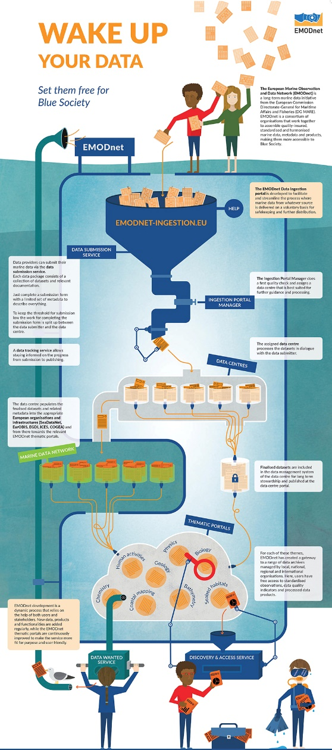
Marketing and outreach activities

Slide 21

Animation ‘Wake up your data’

